Slide 1


The International Baccalaureate
The Diploma Program

Slide 2
What is IB Education? https://player.vimeo.com/video/92725628
The International Baccalaureate (IB) is a global leader in international education developing inquiring, knowledgeable, confident, and caring young people.
IB programs (PYP, MYP, DP, CP) empower school-aged students to take ownership in their own learning and help them develop future-ready skills to make a difference and thrive in a world that changes fast.

Slide 3
IB Mission Statement
The International Baccalaureate aims to develop inquiring, knowledgeable and caring young people who help to create a better and more peaceful world through intercultural understanding and respect.
To this end the organization works with schools, governments and international organizations to develop challenging programs of international education and rigorous assessment.
These programs encourage students across the world to become active, compassionate and lifelong learners who understand that other people, with their differences, can also be right.

Slide 4

Why is IB Different?

Slide 5
1. International Mindedness
The aim of all IB programs is to develop internationally minded people who recognize their common humanity and shared guardianship of the planet. Central to this aim is international-mindedness.
International-mindedness is a multi-faceted and complex concept that captures a way of thinking, being and acting that is characterized by an openness to the world and a recognition of our deep interconnectedness to others.

Slide 6
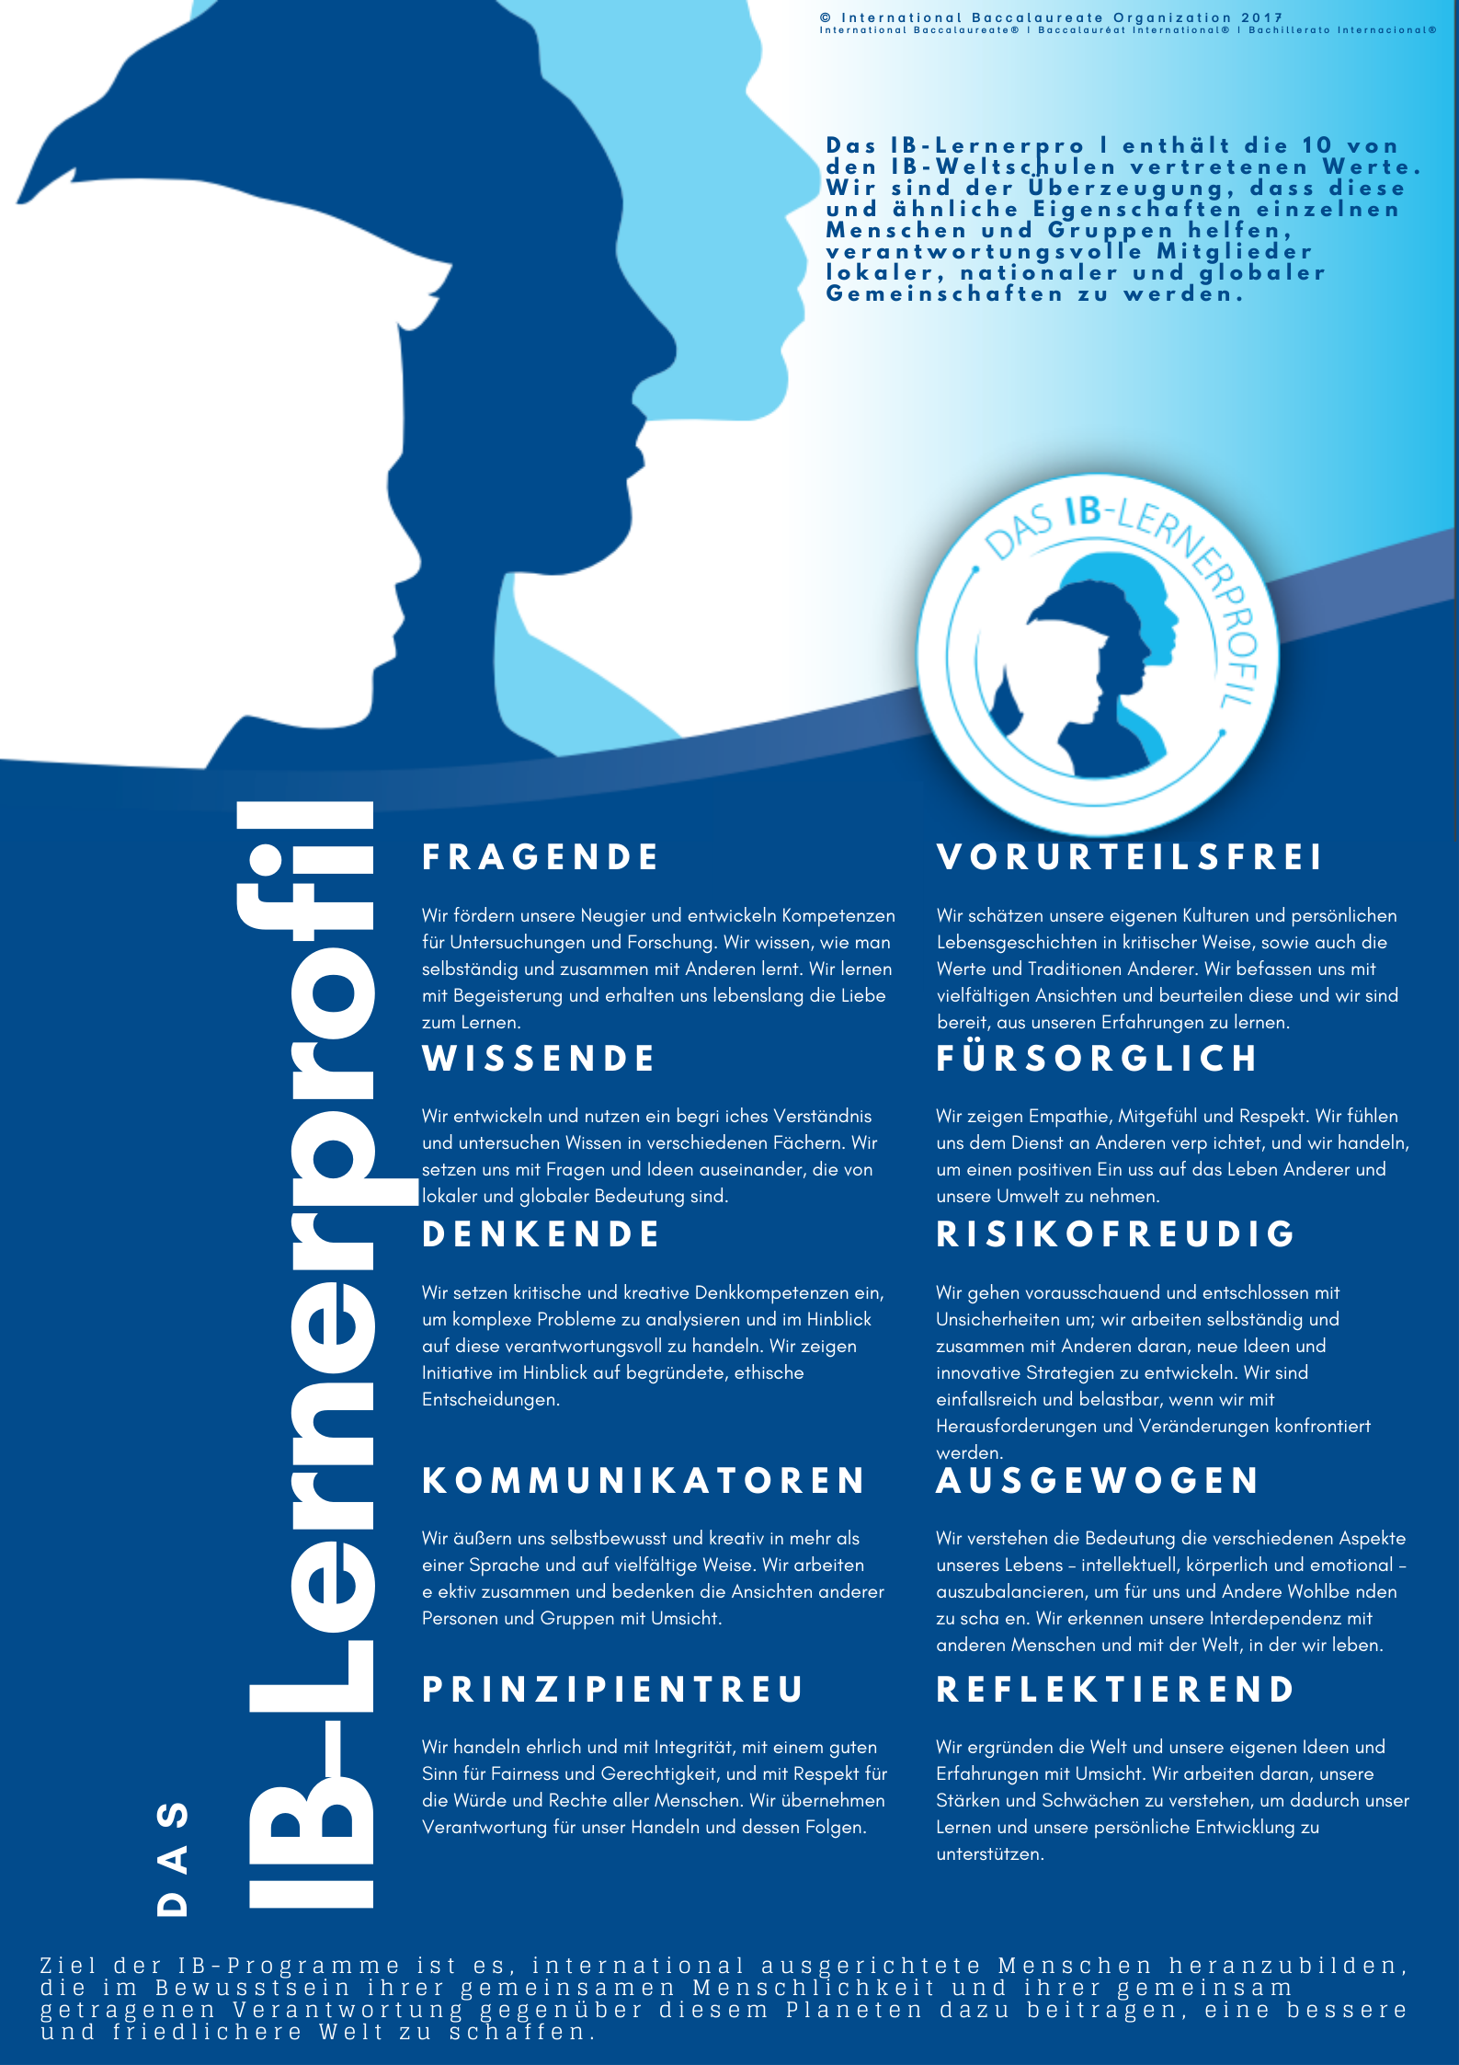
2. IB Learner Profile https://player.vimeo.com/video/66637103
The IB learner profile places the student at the center of an IB education.
The 10 attributes reflect the holistic nature of an IB education.
Inquirers
Knowledgeable
Thinkers
Communicators
Principled
Open-minded
Caring
Risk-takers
Balanced
Reflective.

Slide 7
3. Approaches to Teaching
In all IB programs, teaching is:
Based on inquiry. A strong emphasis is placed on students finding their own information and constructing their own understandings.
Focused on conceptual understanding. Concepts are explored to both deepen disciplinary understanding and to help students make connections and transfer learning to new contexts.
Developed in local and global contexts. Teaching uses real-life contexts and examples, and students are encouraged to process new information by connecting it to their own experiences and to the world around them.
Focused on effective teamwork and collaboration. This includes promoting teamwork and collaboration between students, but also refers to the collaborative relationship between teachers and students.
Designed to remove barriers to learning. Teaching is inclusive and values diversity. It affirms students’ identities and aims to create learning opportunities that enable every student to develop and pursue appropriate personal goals.
Informed by assessment. Assessment plays a crucial role in supporting, as well as measuring, learning. This approach also recognizes the crucial role of providing students with effective feedback.

Slide 8
Approaches to Learning
Thinking skills, including areas such as critical thinking, creative thinking and ethical thinking
Research skills, including skills such as comparing, contrasting, validating and prioritizing information
Communication skills, including skills such as written and oral communication, effective listening, and formulating arguments
Social skills, including areas such as forming and maintaining positive relationships, listening skills, and conflict resolution
Self-management skills, including both organizational skills, such as managing time and tasks, and affective skills, such as managing state of mind and motivation.

Slide 9
What is the DP? https://player.vimeo.com/video/64308996 https://youtu.be/XCJ9029BFnA?si=40ho6ETlW6i8SnWN
The IB Diploma Program (DP) is an academically challenging and balanced program of education with final examinations that prepares students, aged 16 to 19, for success at university and life beyond.
It has been designed to address the intellectual, social, emotional and physical well-being of students.
The program has gained recognition and respect from the world’s leading universities.
The Diploma Program prepares students for effective participation in a rapidly evolving and increasingly global society
The IB Diploma Program is a two-year program for students aged 16-19. (Grades 11 and 12)

Slide 10
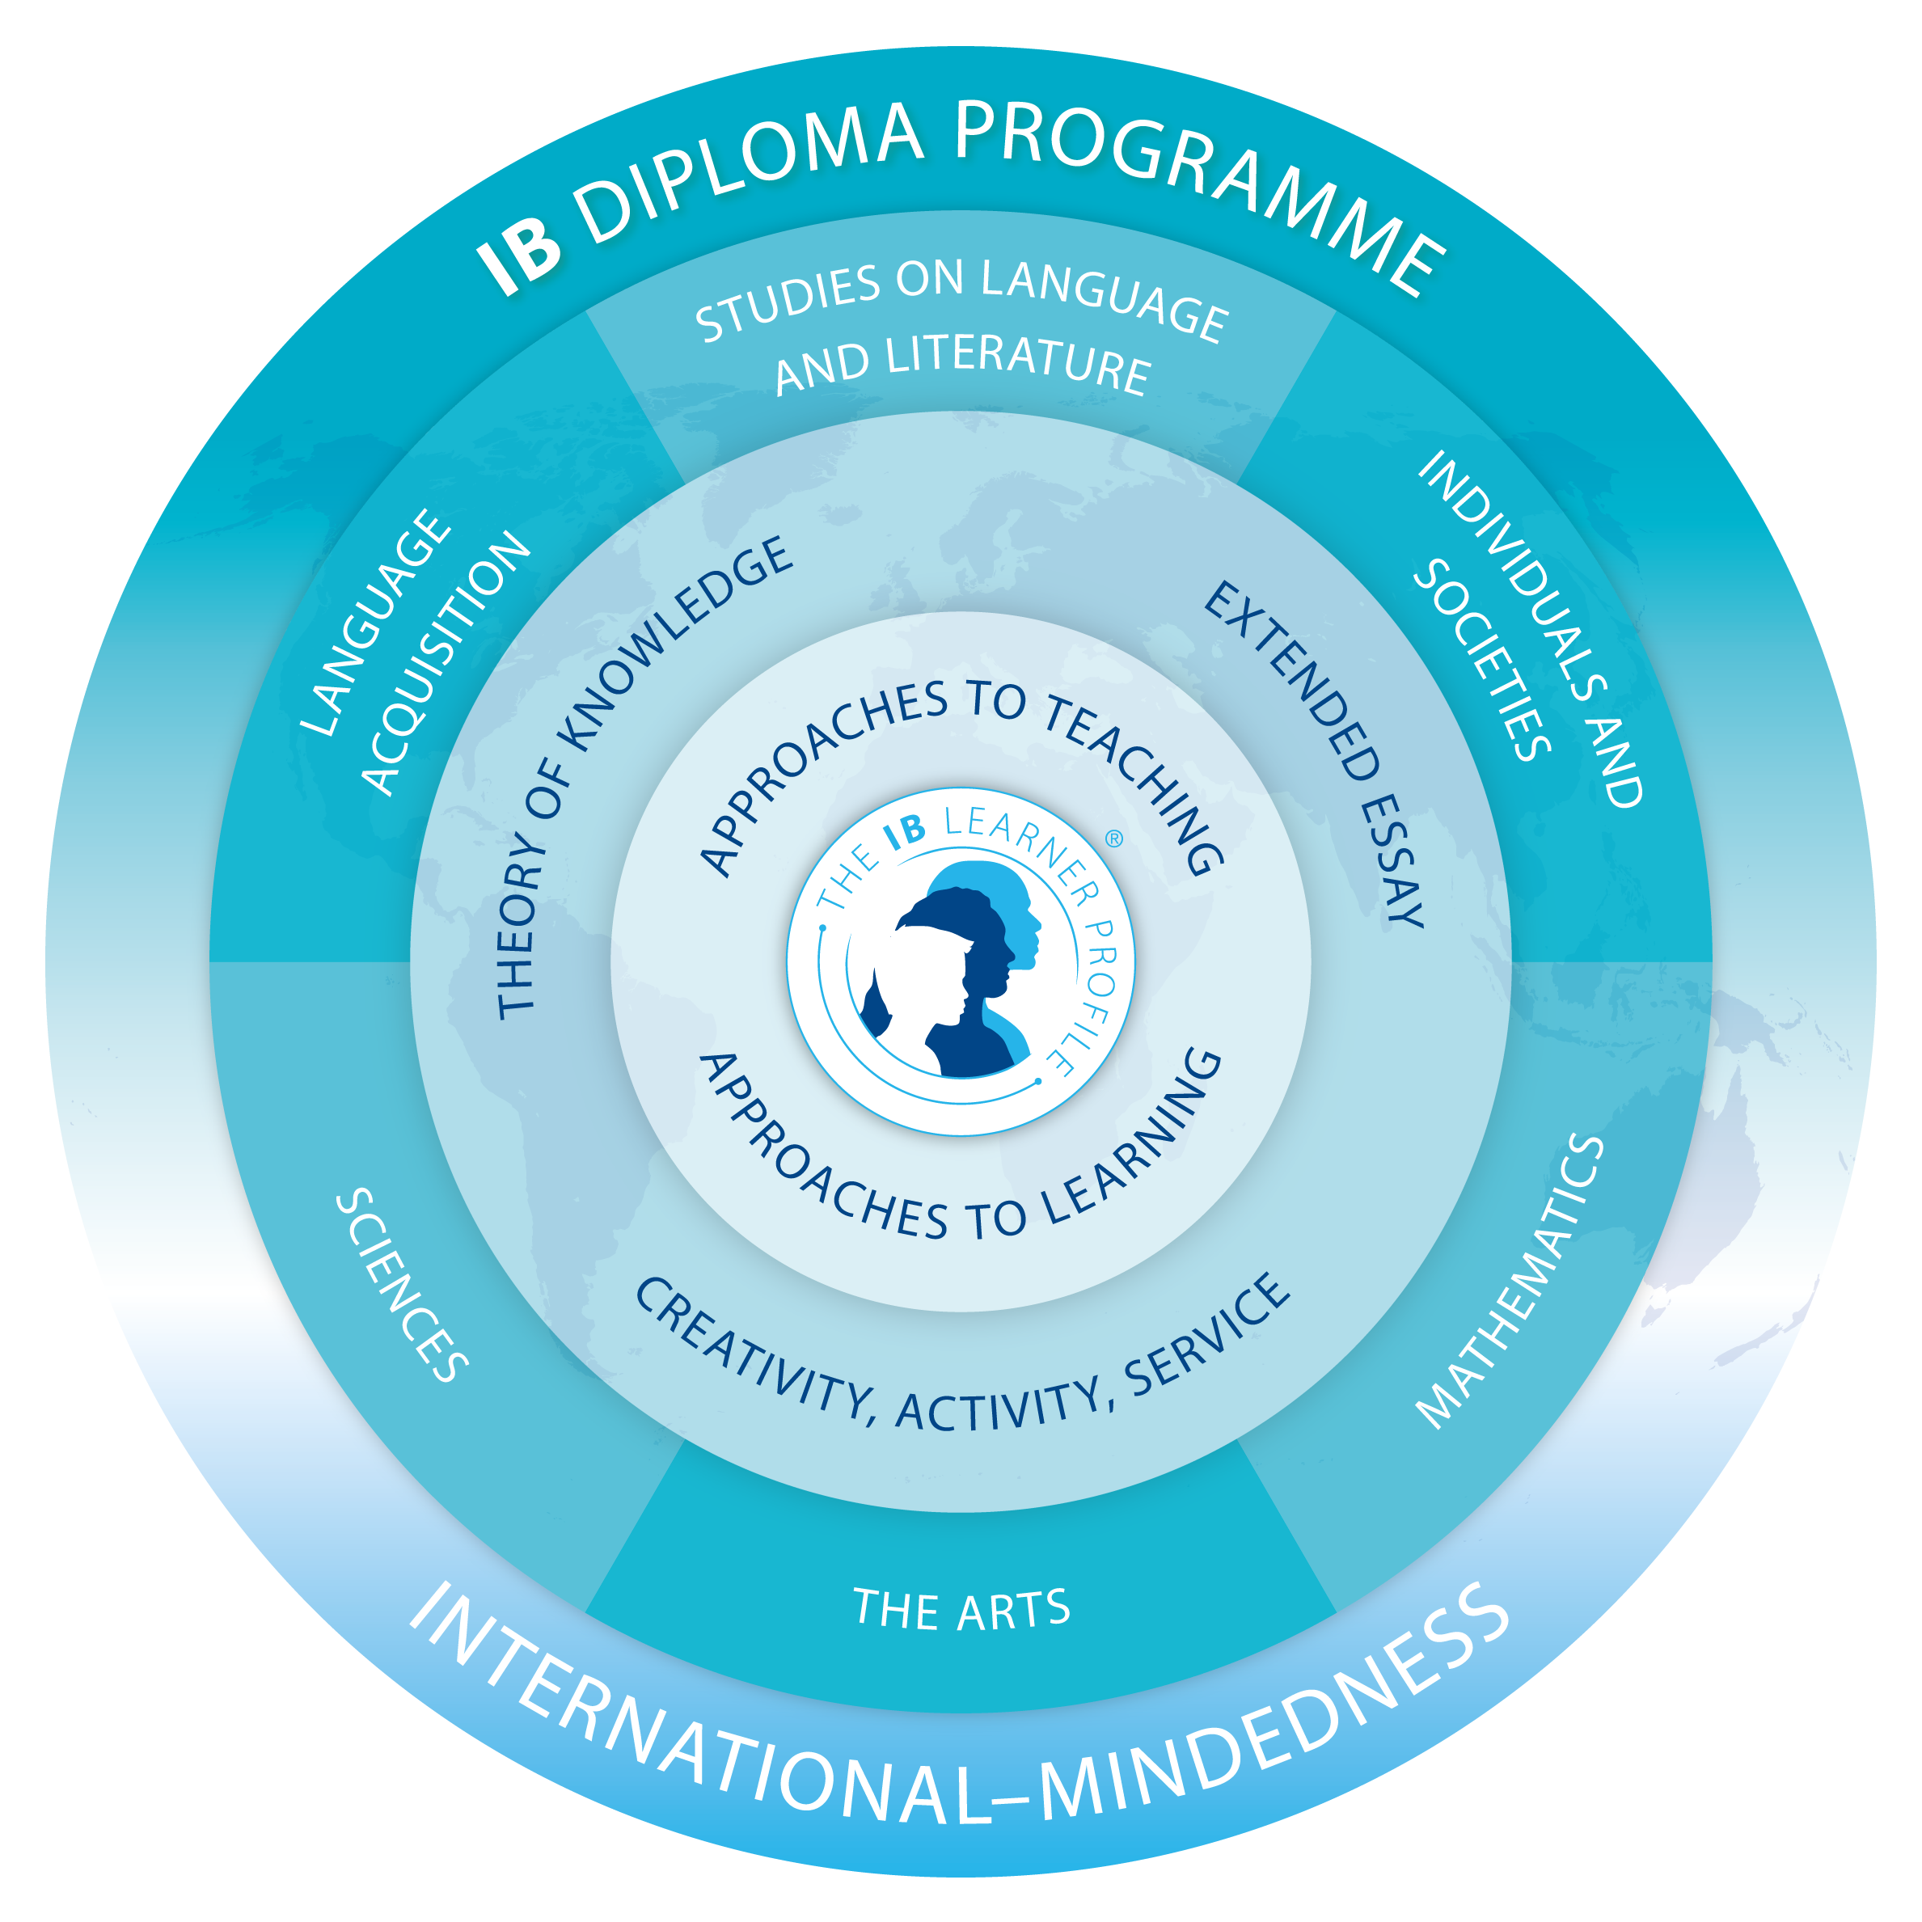
The Diploma Program

Slide 11
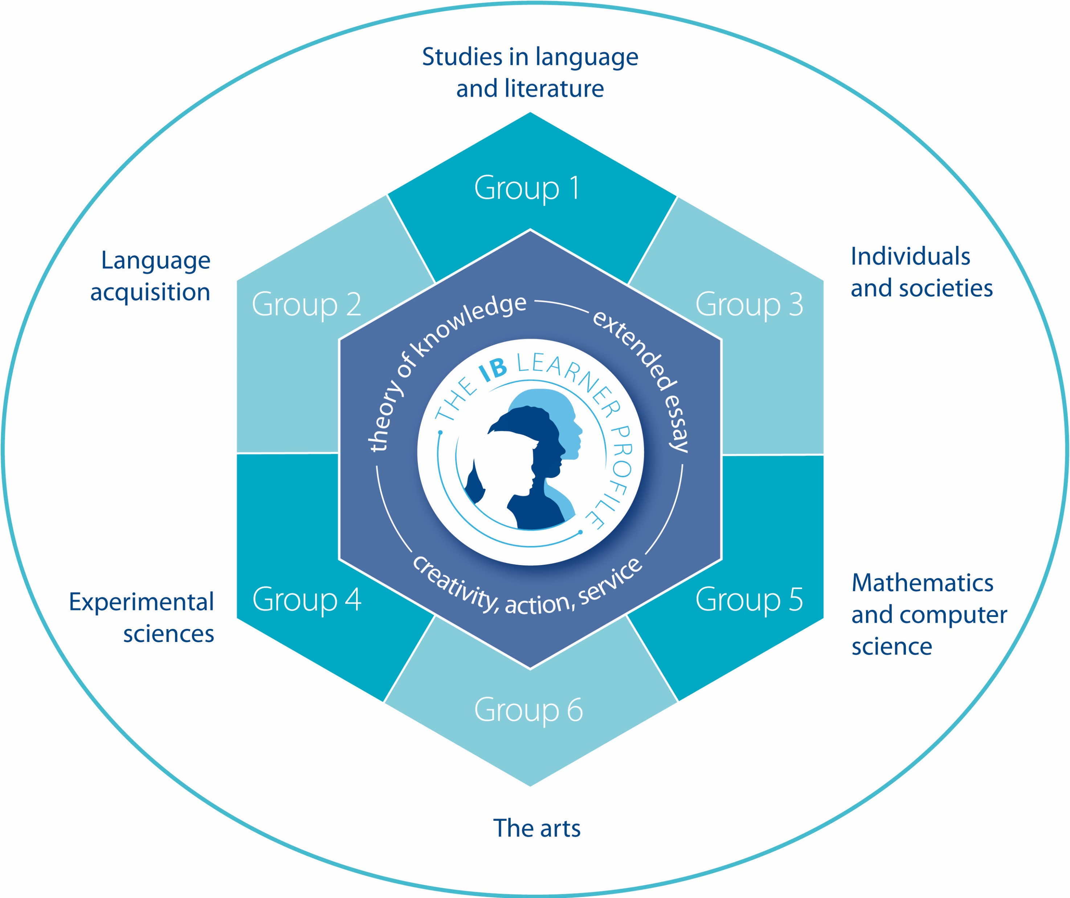
Subject Groups

Slide 12
To achieve the IB Diploma students must choose one subject from each of the five groups (1 to 5), ensuring breadth of knowledge and understanding in their best language, additional language(s), the social sciences, the experimental sciences and mathematics.
I
Students must also choose either an arts subject from group 6, or a second subject from groups 1 to 5.
Requirements
DP subjects can be taken at higher level or standard level. At least three and not more than four subjects are taken at higher level (240 teaching hours), while the other subjects are taken at standard level (150 teaching hours).
Students can study and take examinations, in English, French or Spanish.
Two DP subjects are classified as interdisciplinary subjects and so satisfy the
requirements of more than one subject group:• Literature and performance - group 1 and group 6 • Environmental systems - group 3 and group 4
In addition to disciplinary and interdisciplinary study, the Diploma Program
features three core elements that broaden students’ educational experience and challenge them to apply their knowledge and skills.

Slide 13
The Diploma Program Core
The extended essay asks students to engage in independent research through an in-depth study of a question relating to one of the DP subjects they are studying. The world studies extended essay option allows students to focus on a topic of global significance which they examine through the lens of at least two DP subjects.
Theory of knowledge develops a coherent approach to learning that unifies the academic disciplines. In this course on critical thinking, students inquire into the nature of knowing and deepen their understanding of knowledge as a human construction.
Creativity, action, service (CAS) involves students in a range of activities alongside their academic studies throughout the Diploma Program. Creativity encourages students to engage in the arts and creative thinking. Action seeks to develop a healthy lifestyle through physical activity. Service with the community offers a vehicle for new learning with academic value. The three strands of CAS enhance students’ personal and interpersonal development through experiential learning and enable journeys of self-discovery.

Slide 14
Assessment
External Assessments: Students take written examinations at the end of the program which are marked by external IB examiners.
1
Internal Assessments: Students also complete assessment tasks in the school, which are either initially marked by teachers and then moderated by external moderators or sent directly to external examiners.
2
The marks awarded for each course range from 1 (lowest) to 7 (highest). Students can also be awarded up to three additional points for their combined results on theory of knowledge and the extended essay.
3
The diploma is awarded to students who gain at least 24 points, subject to certain minimum levels of performance across the whole program and to satisfactory participation in the creativity, action, service requirement.
4
The highest total that a Diploma Program student can be awarded is 45 points.
5
Assessment is criterion-related, which means student performance is measured against pre-specified assessment criteria based on the aims and objectives of each subject curriculum, rather than the performance of other students taking the same examinations.
6
The range of scores that students have attained remains statistically stable, and universities value the rigor and consistency of Diploma Program assessment practice.

Slide 15
10 Reasons Why the IB DP is Ideal Preparation for University
It increases academic opportunity
IB students care about more than just results
It encourages you to become a confident and independent learner
It’s an international qualification
Graduates are globally minded
The IB encourages critical thinking
DP students have proven time management skills
It assesses more than examination techniques
Subjects are not taught in isolation
It encourages breadth and depth of learning

Slide 16
University Admissions
A study by the Higher Education Statistics Agency (HESA) in the UK concluded that IB graduates were more likely to enroll in one of the UK’s top 20 Higher Education Institutions (HEIs), when compared to A-level and other student groups with similar qualifications.
IB students also were more likely to receive honors degrees or awards, continue to further studies, and be employed in graduate level positions and higher-paid occupations.
The Chicago Postsecondary Transition Project has studied the impact of Chicago's IB programs on post-secondary outcomes and experiences of graduates. DP graduates, compared to similar non-DP graduates, were not only more likely to enroll in university, but also more likely to enroll in selective universities, to stay enrolled, and to perform better throughout their studies.
The study included 18,075 Chicago Public Schools (CPS) graduates from 12 high schools throughout the city that offered the DP program, mostly serving low income, racially diverse students.

Slide 17

Egyptian Universities Admission Requirements for IBDP Students
The Tanseeq Bureau only accepts original transcripts and diplomas which must have been ratified by the IB governing body in Geneva and legalized by the Egyptian Embassy in Switzerland.
The student must successfully complete the IB Diploma’s six required subjects.
English Language must be among the six subjects.
The student must successfully complete at least three advanced-level courses of the IB curriculum.
Within the Languages Groups (A or B), Arabic Language may be counted among the diploma’s six required subjects (with adherence to the regulations of the Ministry of Education in this regard).
The student must complete the below additional requirements:
Presenting an Extended Essay
Completing the Theory of Knowledge course of the IB Diploma
Passing the Creativity, Activity and Service core

Slide 18

Qualifying Subjects
Scientific Faculties
Holders of the IB Diploma must successfully complete high level IB courses in Chemistry and Biology if they seek to enroll at the below faculties in Egyptian universities:
Medicine
Dentistry
Pharmacy
Nursing
Veterinary Medicine
Physiotherapy

Slide 19
 | 1 8:00 – 9:00 | 2 9:00 – 10:00 | 3 10:00 – 11:00 | Break 11:00- 11:30 | 4 11:30-12:30 | 5 12:30-1:30 | 6 1:30-2:30 | 7 2:30-3:15
Sun | Literature & Performance SL | Math A&A SL | Hist. HL |  | Bio. HL | Chem. HL | Spanish Ab initio SL
Mon | Math A&A SL | Hist. HL | Bio. HL |  | Chem. HL | Spanish Ab initio SL | Literature & Performance SL
Tues | Hist. HL | Bio. HL | Chem. HL |  | Spanish Ab initio SL | Literature & Performance SL | Math A&A SL
Wed | Bio. HL | Chem. HL | CAS |  |  |  | TOK
Thurs |  |  | Hist. HL |  | CAS | TOK | EE
Sun |  |  | Hist. HL |  | Bio. HL | Chem. HL | CAS
Mon | Math A&A SL | Hist. HL | Bio. HL |  | Chem. HL | Spanish Ab initio SL | Literature & Performance SL
Tues | Hist. HL | Bio. HL | Chem. HL |  | Spanish Ab initio SL | Literature & Performance SL | Math A&A SL
Wed | Bio. HL | Chem. HL | CAS |  | TOK
Thurs |  |  | Hist. HL |  | CAS |  | TOK

Slide 20

Mathematical Faculties
Holders of the IB Diploma must successfully complete high level IB courses in Math and Physics if they seek to enroll at the below faculties in Egyptian universities:
Engineering
Computer Science
Urban Planning
Fine Arts (Architecture)

Slide 21
 | 1 8:00 – 9:00 | 2 9:00 – 10:00 | 3 10:00 – 11:00 | Break 11:00- 11:30 | 4 11:30-12:30 | 5 12:30-1:30 | 6 1:30-2:30 | 7 2:30-3:15
Sun | Literature & Performance SL | Math A&A HL | ECO SL |  | Phys. HL | Chem. HL | Spanish Ab initio SL
Mon | Math A&A HL | ECO SL | Phys. HL |  | Chem. HL | Spanish Ab initio SL | Literature & Performance SL
Tue | ECO SL | Phys. HL | Chem. HL |  | Spanish Ab initio SL | Literature & Performance SL | Math A&A HL
Wed | Phys. HL | Chem. HL | CAS |  |  |  | TOK
Thur. |  | Math A&A HL |  |  | CAS | TOK | EE
Sun |  | Math A&A HL |  |  | Phys. HL | Chem. HL | CAS
Mon | Math A&A HL | ECO SL | Phys. HL |  | Chem. HL | Spanish Ab initio SL | Literature & Performance SL
Tue | ECO SL | Phys. HL | Chem. HL |  | Spanish Ab initio SL | Literature & Performance SL | Math A&A HL
Wed | Phys. HL | Chem. HL | CAS |  | TOK
Thur. |  | Math A&A HL |  |  | CAS |  | TOK

Slide 22
Conversion for Enrolment in Egyptian Universities
(Score-to-Percentage)
Score (including bonus points) | Percentage | Score (including bonus points) | Percentage
24 (minimum score) | 75.70% | 35 | 95.55%
25 | 78.10% | 36 | 96.55%
26 | 80.40% | 37 | 97.40%
27 | 82.55% | 38 | 98.15
28 | 84.70% | 39 | 98.70%
29 | 86.65% | 40 | 99.15%
30 | 88.55% | 41 | 99.45%
31 | 90.25% | 42 | 99.70%
32 | 91.80% | 43 | 99.80%
33 | 93.15% | 44 | 99.90%
34 | 94.45% | 45 (maximum score) | 99.95%

Slide 23

Pathways to University
The DP is recognized worldwide and accepted by all major universities internationally
Many universities in America and Canada offer credit points (for HL subjects) for the first year of their university courses to high DP achievers

Slide 24

The DP Compared to Other Qualifications
AP (Advanced Placement)
A 2015 study by the Educational Policy Improvement Center revealed that students viewed AP only as a means to obtain college credit in high school, while the DP is considered a holistic program that develops strong life-long learners.
A-Levels
An Ofqual report from 2012 described the assessments in the Diploma Program as excellent for allowing differentiation, for encouraging independent thinking and research skills, and for allowing students to demonstrate higher order skills.
In 2014, the Universities and Colleges Admissions Service (UCAS) developed a new tariff system that gave the International Baccalaureate an official A-level equivalence.

Slide 25
Perceptions of University Officials https://youtu.be/UYi_Jy-9_4M https://vimeo.com/329993485
“It’s the most secure foundation available for successful college graduation.”
Jonathan Burdick, Dean of College Admission, University of Rochester, USA
“This is an invaluable experience for a liberal arts education that emphasizes critical thinking.”
Madhavi Menon, Director, Center for Studies in Gender and Sexuality and Professor of English, Ashoka University, India

Slide 26
Bibliography
International Baccalaureate: https://www.ibo.org
Diploma Programme: https://www.ibo.org/programmes/diploma-programme/

